Slide 2
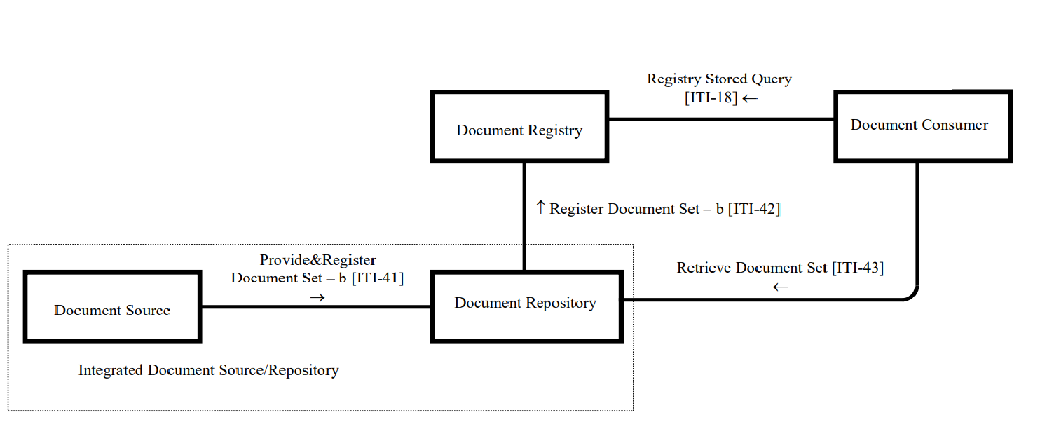
XDS Registry Blockchain

